Slide 1
Advocacy activities
in District 26
Advocacy Chair of District 26
Mariko Kambe

Slide 2
Presentation Details
① International day of the girl child
② Zonta says NO to violence against women
③ Activities in Rose Day
④ Starfish Project
⑤ New Activities

Slide 3
① International day of the girl child
② “Zonta says NO to violence against women”
③ Activities in “Rose Day”
④ “Star fish” Project
⑤ New Activities

Slide 4
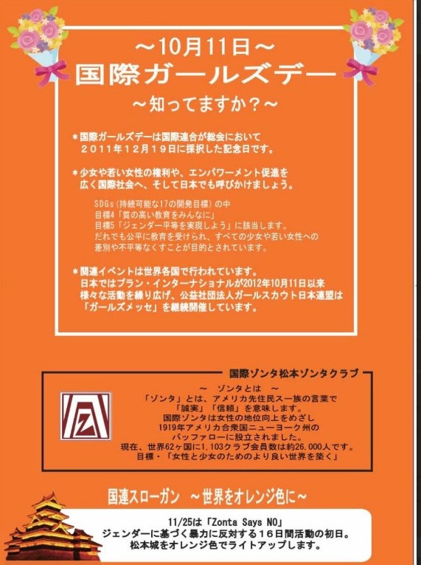
International day
of the girl child
1. Matsumoto ZC

Slide 5
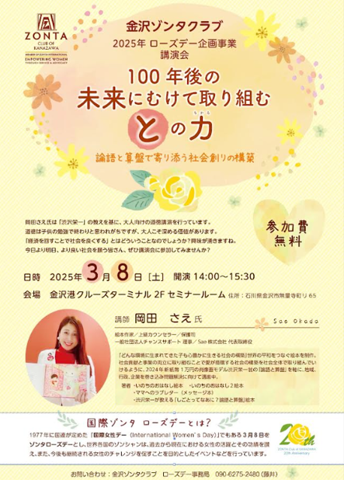
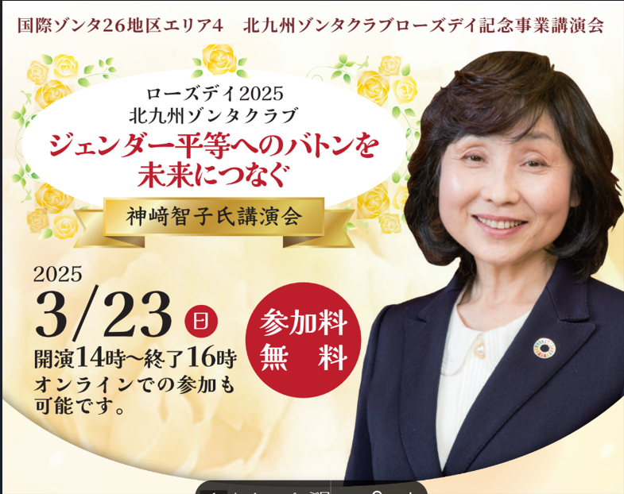
４. Tokyo III ZC
２. Kanazawa ZC
3. Kitakyusyu ZC

Slide 6
①nternational day of the girl child
② Zonta says NO to violence against women
③ Activities in “Rose Day”
④ “Star fish” Project
⑤ New Activities

Slide 7
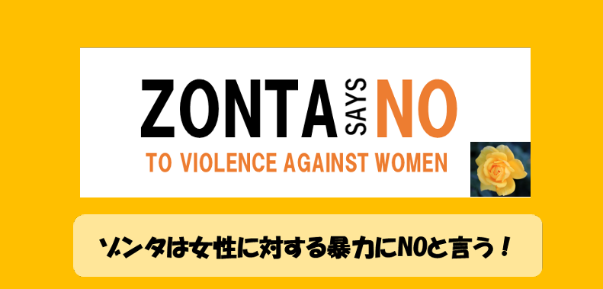
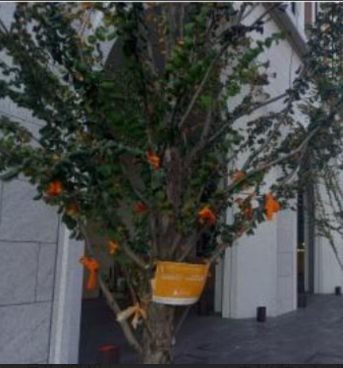
The Zonta Says NO
to Violence against Women
Attempts in Bunkyo Ward, Tokyo

Slide 8
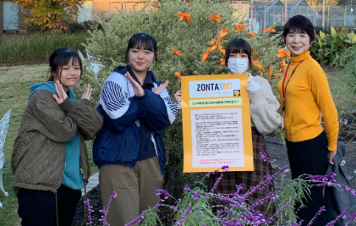
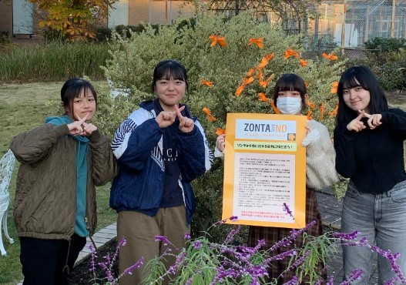
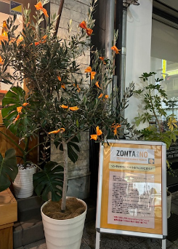
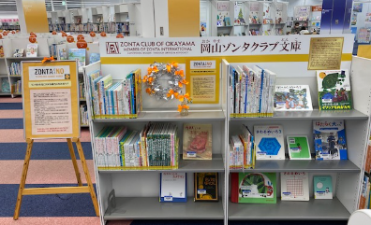
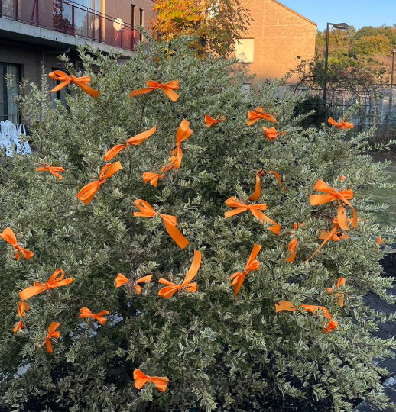
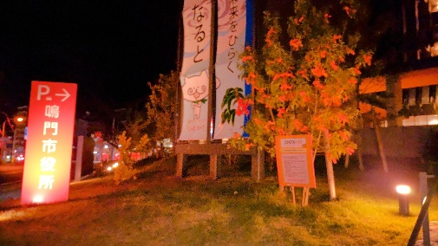
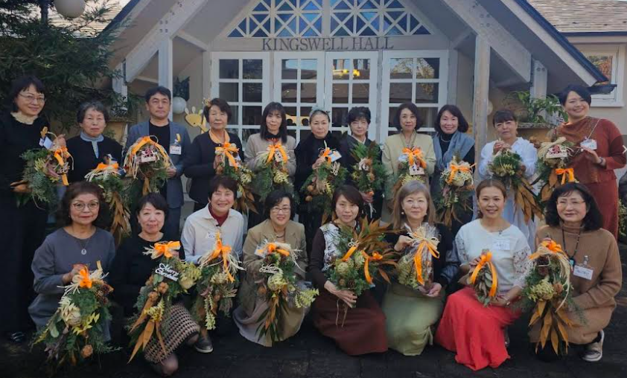
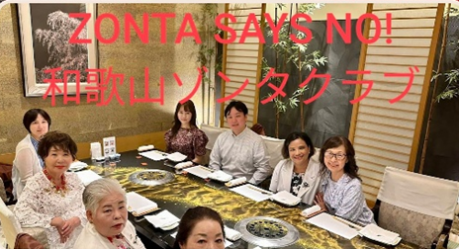
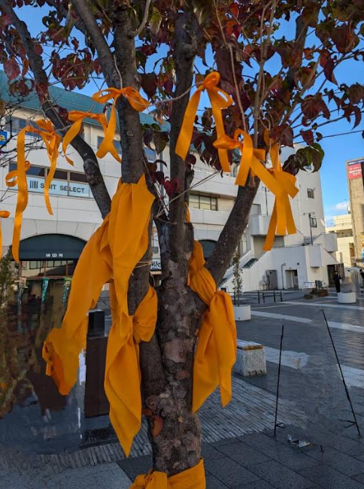
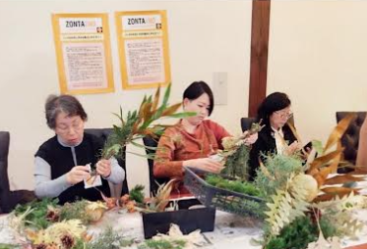
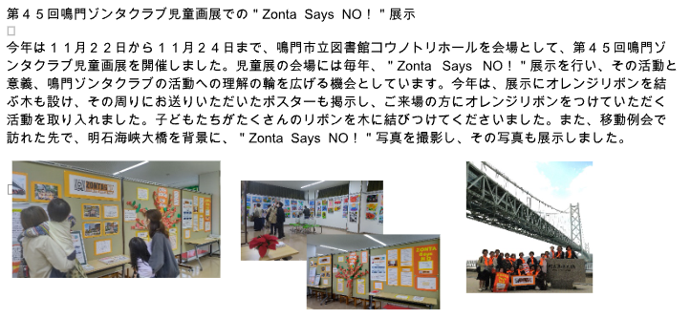
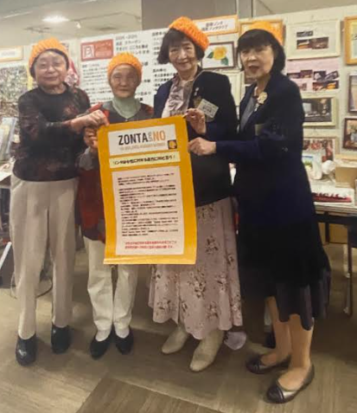
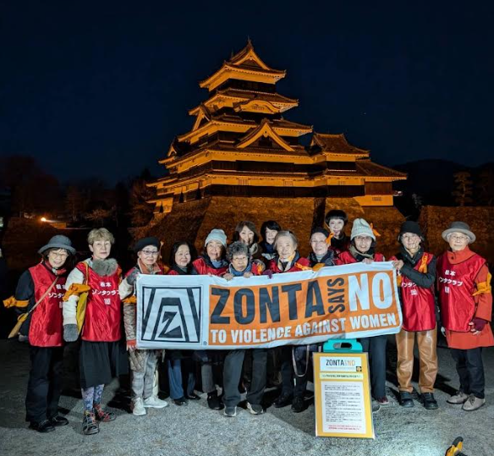
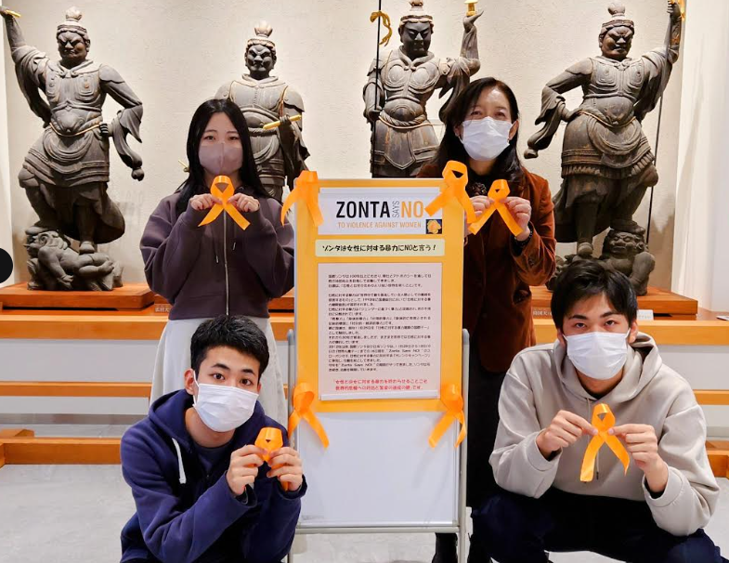
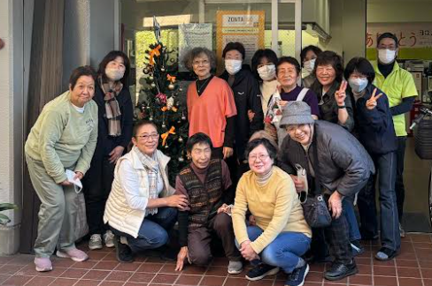
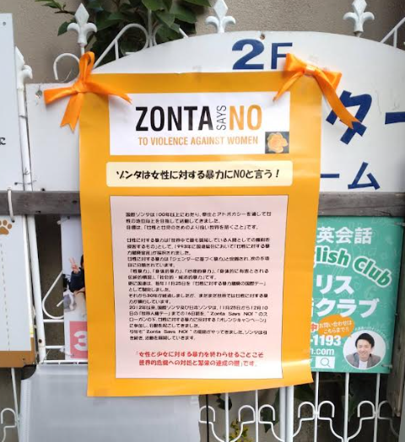
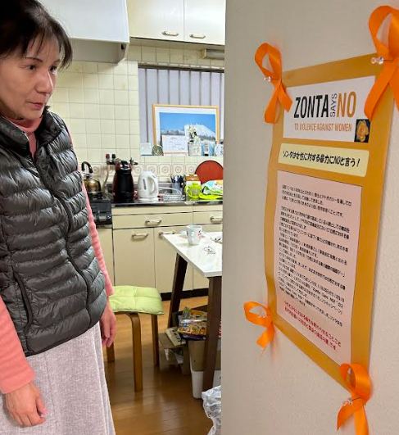
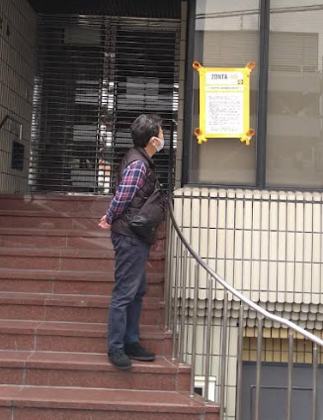
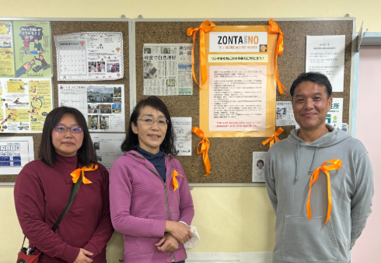
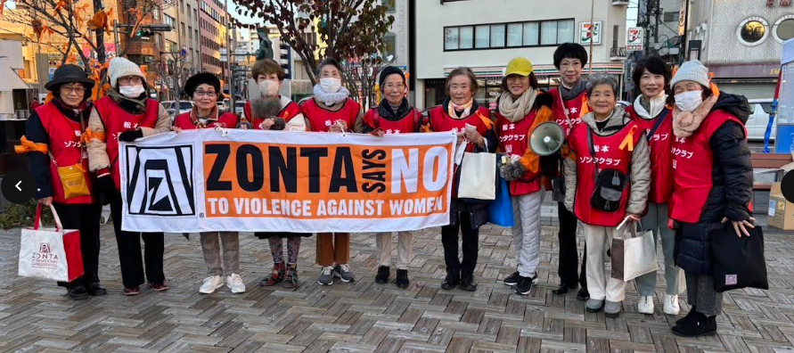
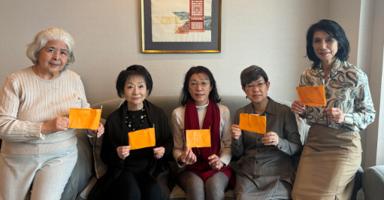
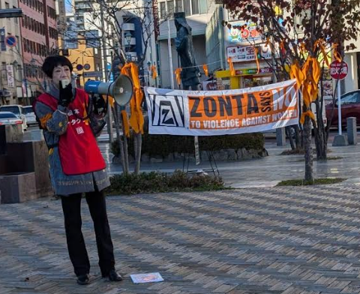

Slide 9
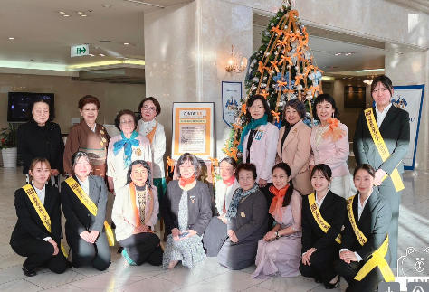
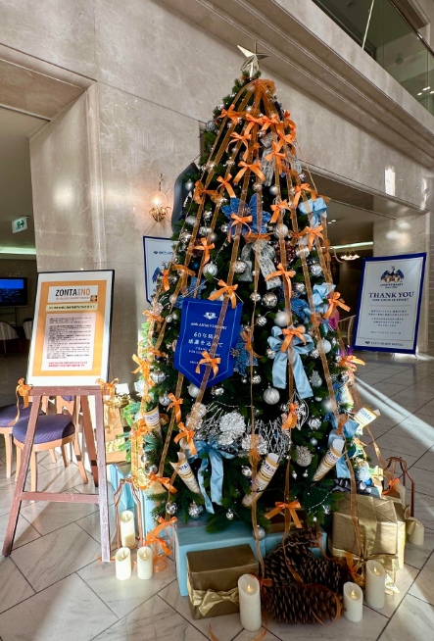
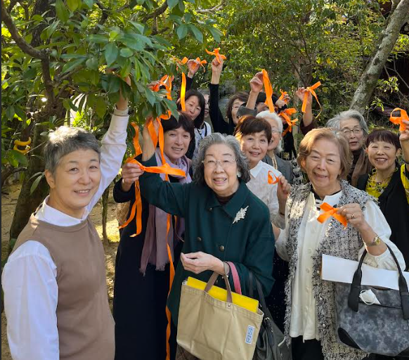
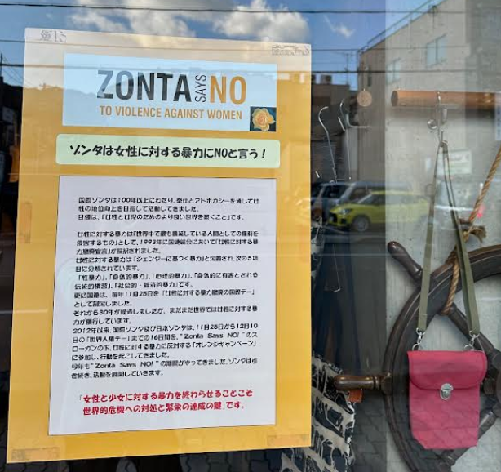
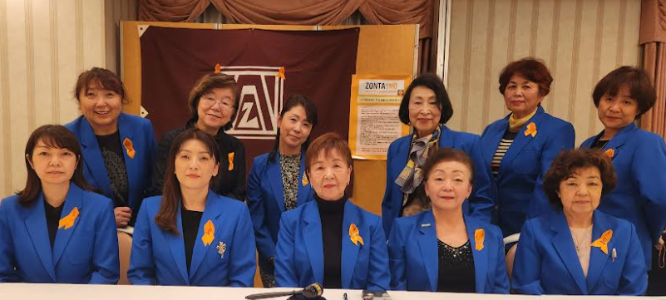
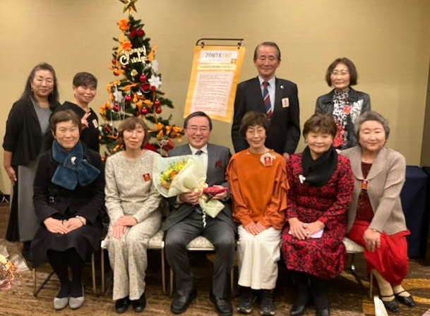
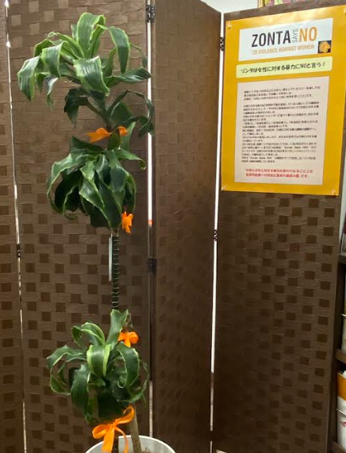
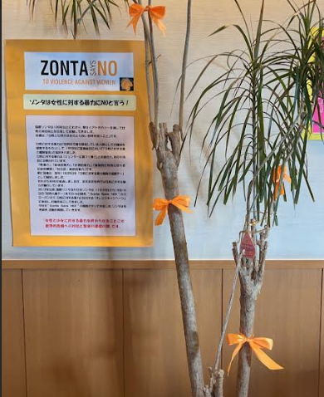
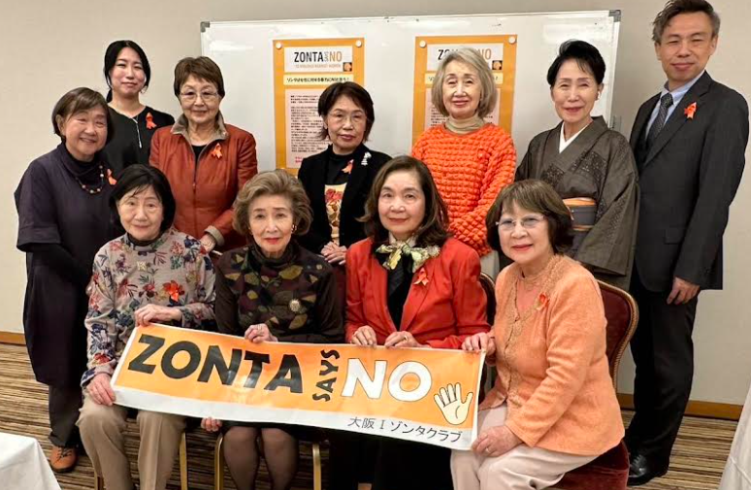
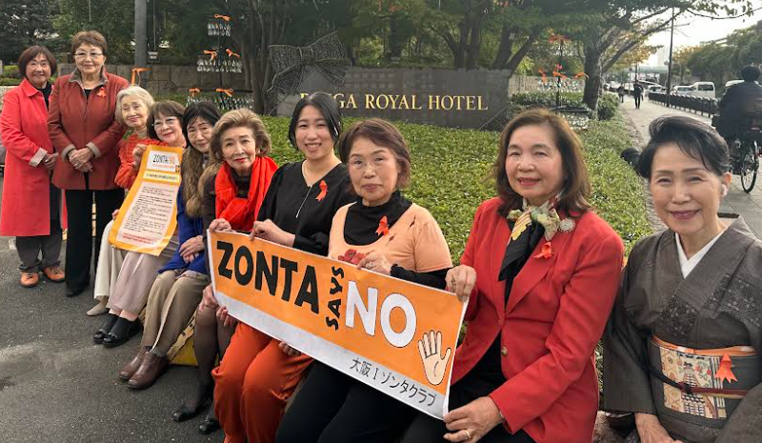
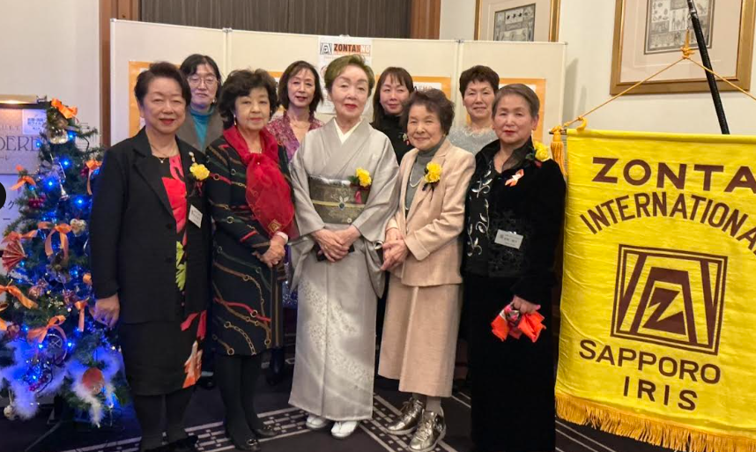
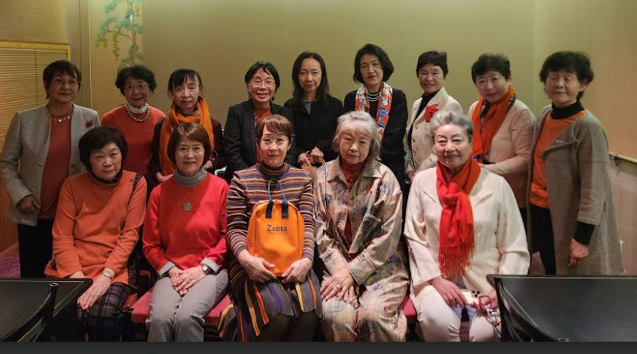
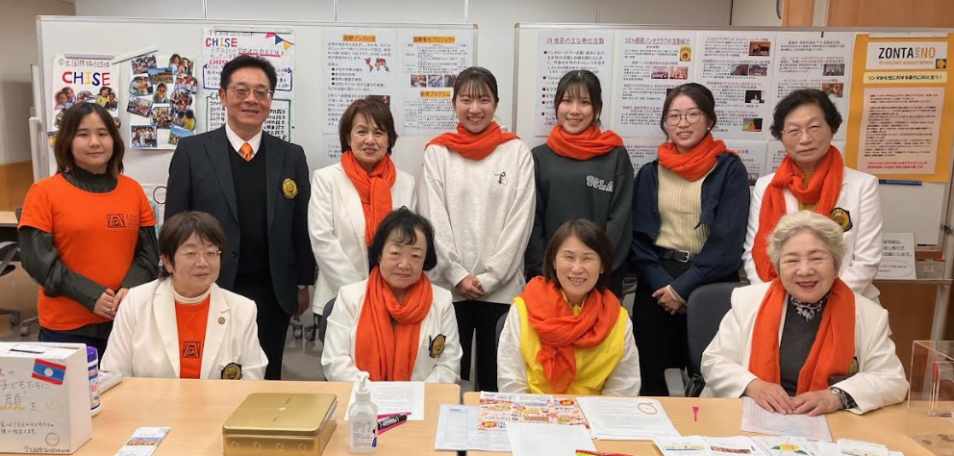
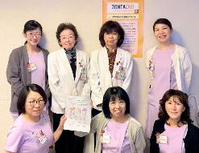
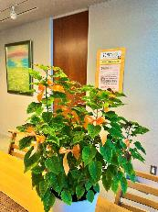
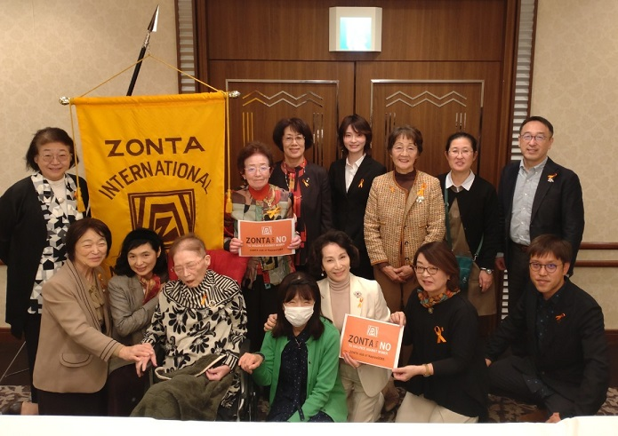
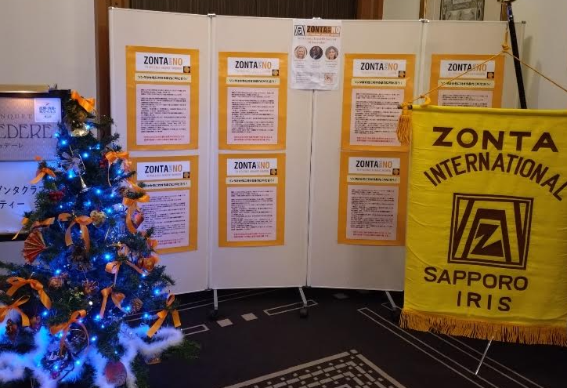
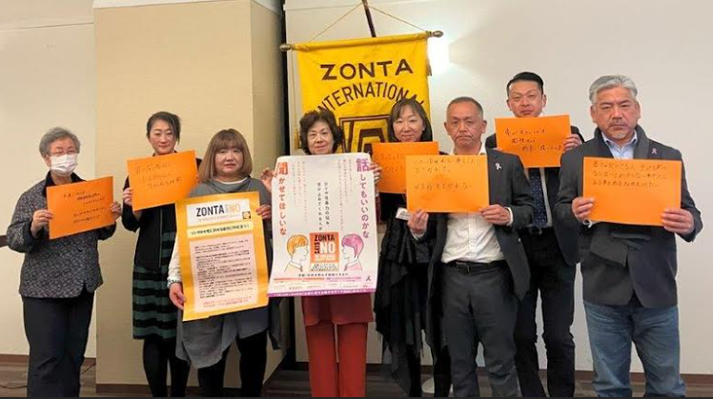
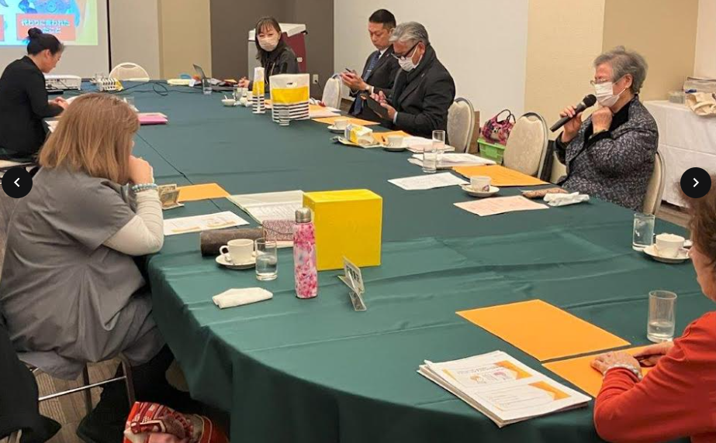
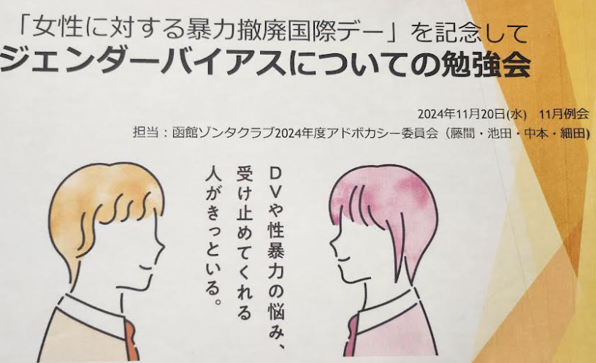

Slide 10
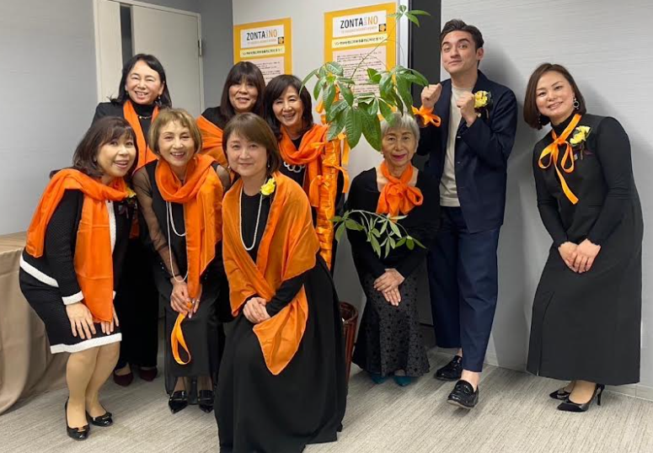
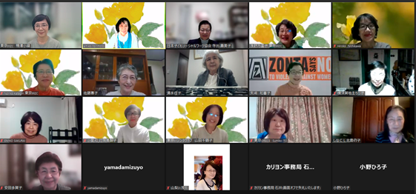
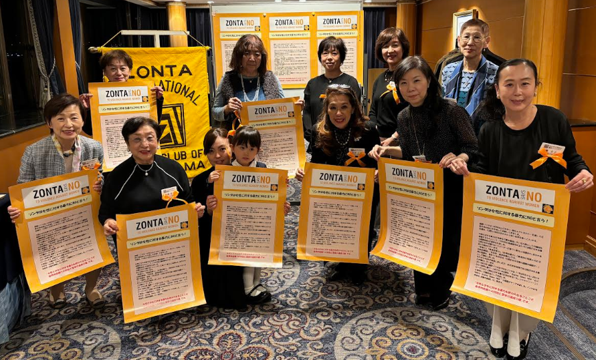

Slide 11
① International day of the girl child
② “Zonta says NO to violence against women”
③ Activities in Rose Day
④ “Star fish” Project
⑤ New Activities

Slide 12
Activities of ROSE DAY
In the days around Rose Day on March 8,
all clubs in District 26 carry out various activities.
Here is a list that summarizes the activities.
Donation or
Events
AREA
Nos of clubs
Lectures
AREA 1
8
５
2
AREA 2
12
4
４
AREA 3
11
4
6
AREA 4
11
4
4

Slide 13
① International day of the girl child
② “Zonta says NO to violence against women”
③ Activities in “Rose Day”
④ Starfish Project
⑤ New Activities

Slide 14
Starfish Project
～We want to help as many Women and Girls as possible～
so many starfish left
on the seashore！
Once return them to the sea, they will survive and come back again
2022~
Zonta International D26 “Team Starfish”

Slide 15
Starfish Project
The name comes from the idea that
“when you find a weakened starfish washed up on the shore,
you immediately return it to the sea.”

Slide 16
① International day of the girl child
② “Zonta says NO to violence against women”
③ Activities in “Rose Day”
④ “Star fish” Project
⑤ New Activities

Slide 17
New Projects of District 26 ：
To hold study sessions to learn about how climate change negatively affects lives of women and girls
To request the government to establish
some support centers where young women
who have started working can go for advice
when they face difficulties

